Slide 1
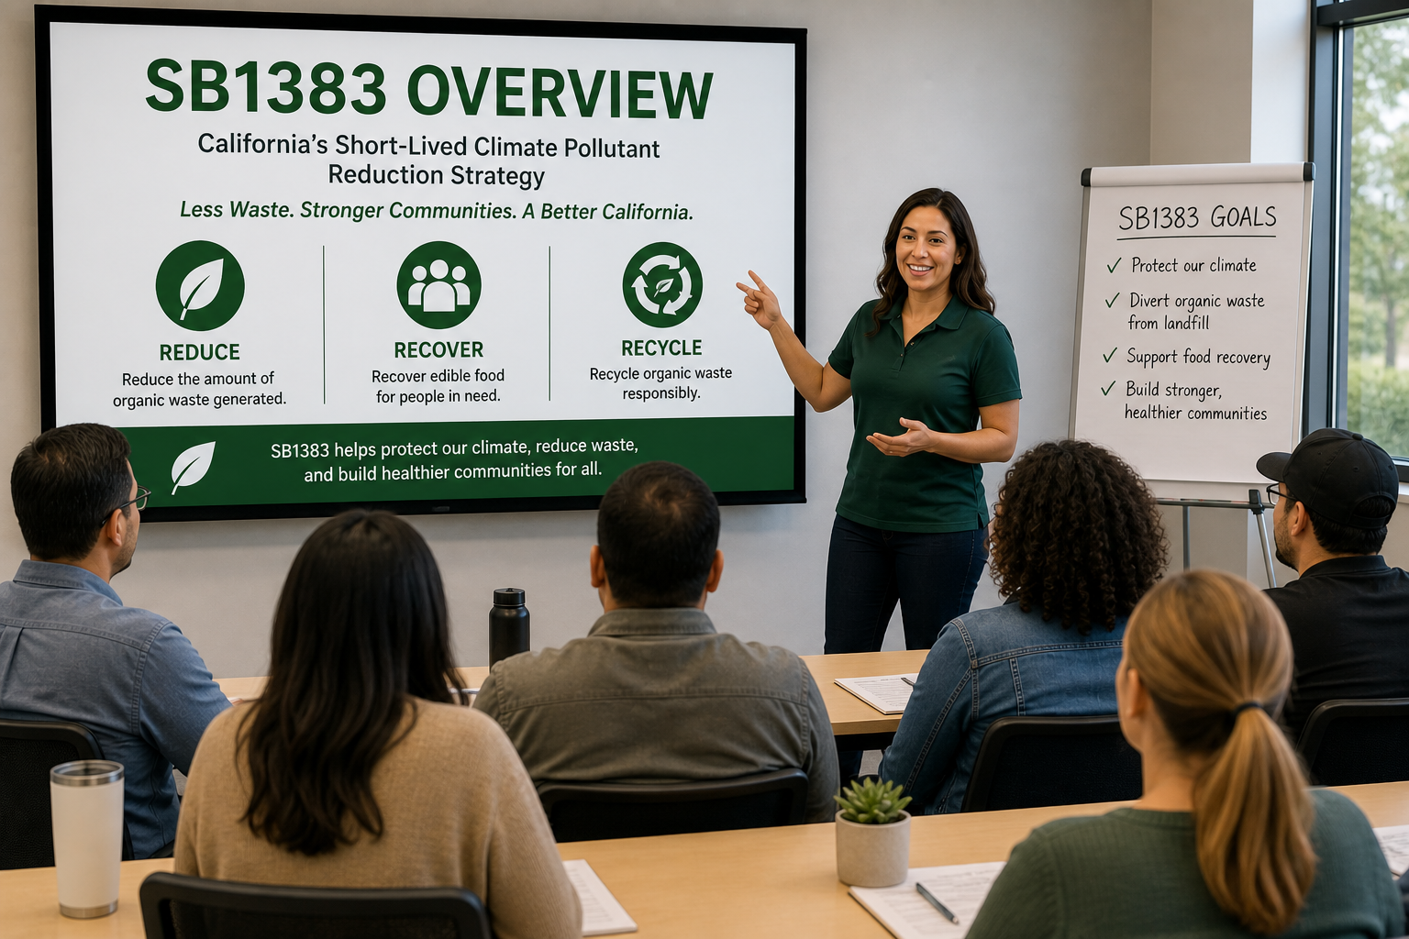
SB 1383 Tier 2 Food Recovery
Presented by Sacramento County Environmental Management Department

Slide 2
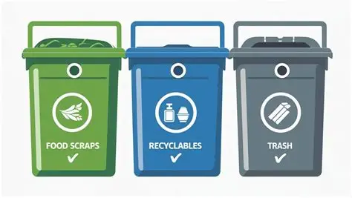
EMD’s Role in SB1383
Local Enforcement Agency
Conduct inspections
Provide education & support
Ensure compliance

Slide 3

What FROs need to receive Tier 2 food
    Need infrastructure to safely receive Tier 2 food
      Adequate refrigeration and/or freezers
      Thermometers
      Storage space
      Food handling areas
      Transportation
      Personnel that is trained on food safety
Notes:
Talk about temperature control requirements for PHFs (food kept at 41F or below,
Thermometers (measure food temperature to ensure food in not entering the danger zone 42-F-134F,
Storage space Big enough to accomendate all the Tier 2 food to be accepted (food stored so there is no cross contamination, Raw food separate with ready to eat food, raw food stored based on final cooking temperatures, must be off the floor.
Food handling areas must be smooth, easily cleanable, prep tables must be a surface that can be easily cleanable (stainless steel).
Transportation: Must be within 30 minutes from facility donating food. Vehicles should be clean to prevent food contamination
Food safety training- talk about manager’s food safety certificate and food handler cards.. When is food not safe for consumption (out of temperature, moldy/damaged food, cross contamination, vermin issues, employee hygiene, handwashing, food recalls, etc)
Recommend use of logs to monitor refrigerator temperatures and have procedures on what to do if refrigeration goes down

Slide 4
Types of Permits
Restaurant with a bar (PE1621)
  This permit is issued to a facility that engages in full food preparation activities. In addition to the main kitchen, this facility also contains an alcoholic beverage bar.
    Examples include cooking with type I hood, cooling, reheating, hot or cold holding, assembly, table service and/or take-out.

Slide 5
Types of Permits
Restaurant (PE1622)
  This permit is issued to a facility that engages in full food preparation activities including; cooking with a type I hood, cooling, reheating, hot or cold holding, assembly, table service and/or take-out

Slide 6
Types of Permits
Restaurant (PE1623)
  This permit is issued to a facility that engages in reduced food preparation activities including; cooking without a type I hood, reheating of manufacturer pre-cooked food, hot or cold holding, assembly, table service and/or take-out.

Slide 7
Types of Permits
Charitable Feeding Facility (PE1689)
  This permit is issued to a non-profit charitable organization that prepares and serves PHF’s for charitable feeding which may require thawing, cooking, cooling, reheating, and/or hot holding for unlimited number of days.
  Example:
  1689 is limited food prep activities such as a fully cooked frozen lasagna (ex: Stouffer’s or from a permitted food facility) that is portioned for food service or a site that makes simple deli sandwiches (ex: ham and cheese sandwich).
Notes:
Can not cook food from a raw state. Doesn’t need plan review. Must have a handsink and either a warewash sink or can use the 3 bucket system.

Slide 8
Types of Permits
Charitable Feeding Registration/Food Pantry (PE1690)
  This permit is issued to a facility that stores and gives away prepackaged food, raw whole produce, or shell eggs directly to people in need. This facility does not engage in any type of food preparation, except portioning of non-PHF foods.
Note: A permit is not required if the facility is not storing food overnight.
Notes:
Only manufacturer’s sealed pre-packaged food.

Slide 9
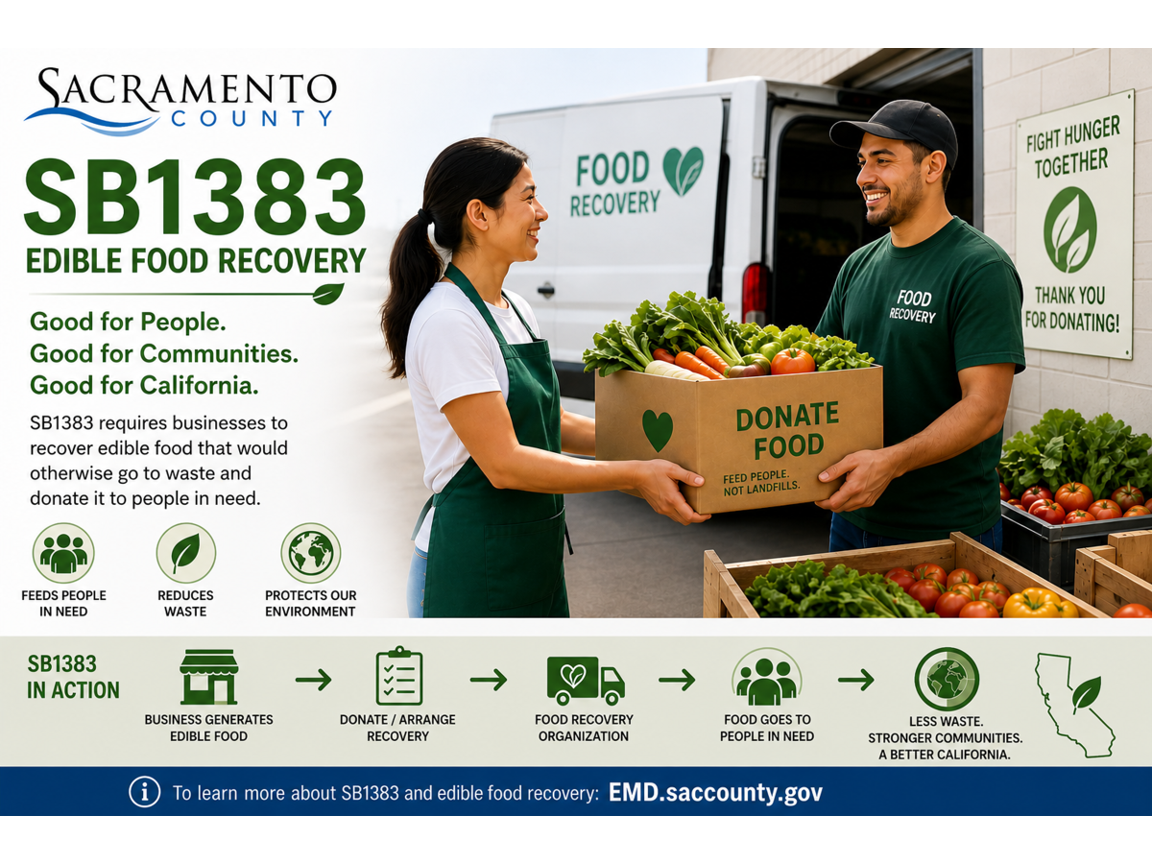
Questions?

